Slide 1
DXA Interpretation

Slide 2
NOMENCLATURE
DXA, not DEXA
T-score should be used with no italics not T score, t-score, or t score.
These should be expressed to one decimal digit, eg, -2.3, not -2 or -2.31
Bone mineral density (BMD) should be expressed to three decimal digits, eg, 0.946 g/cm²

Slide 3
Identification characters
Note the:
Name
Age
Sex
Ethnicity
Weight
Height

Slide 4
Spine Scan

Slide 5
Good scan criteria?
Spine should be straight.
Correct ROI
Correct numbering
No artifact

Slide 6
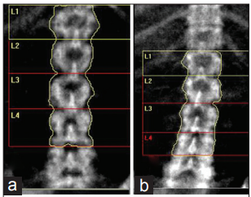
Spine should be straight.

Slide 7
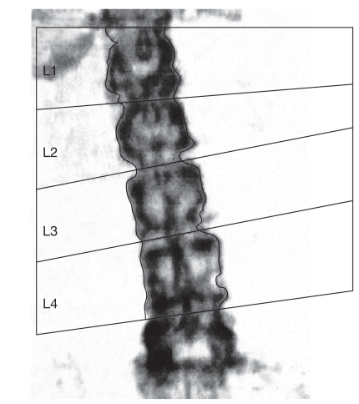

Slide 9
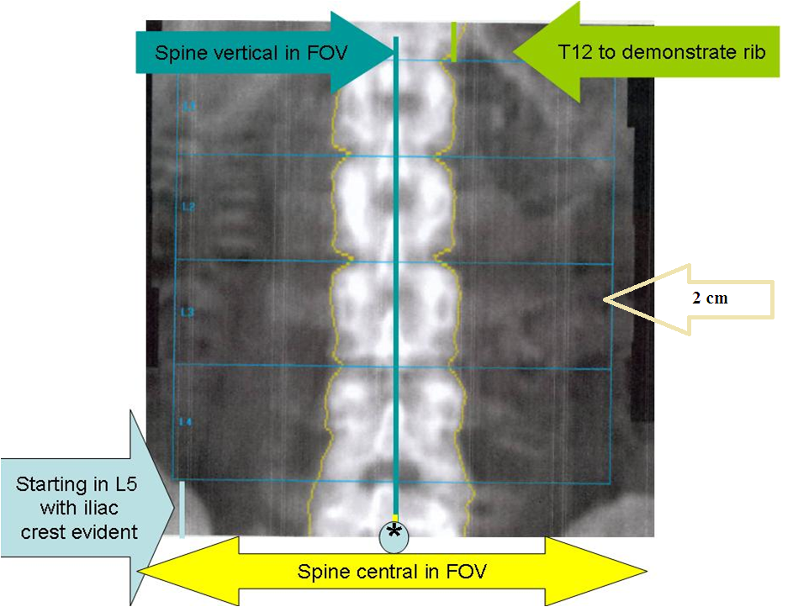
ROI

Slide 12
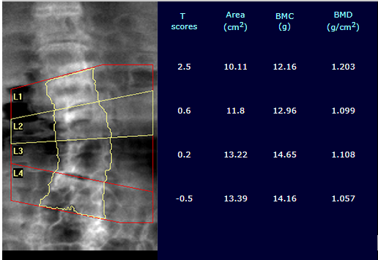
In patients with scoliosis, measurement of BMD becomes invalid

Slide 13
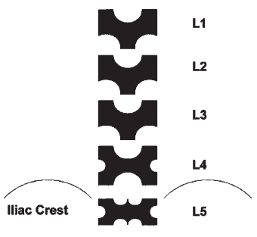
Numbering

Slide 14
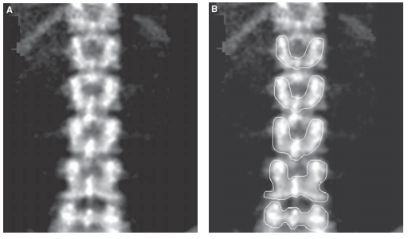

Slide 15
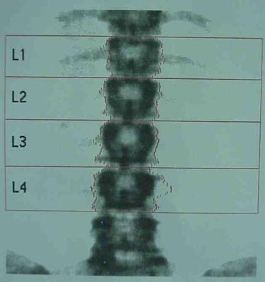
Wrong levels

Slide 19
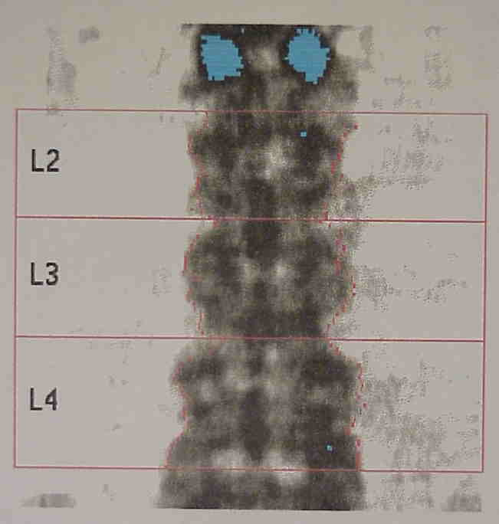
Vertebroplasty

Slide 20
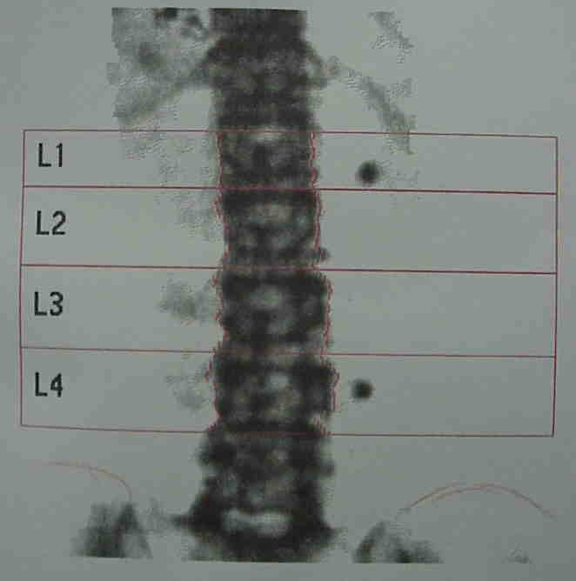
Calcium Tablets

Slide 21
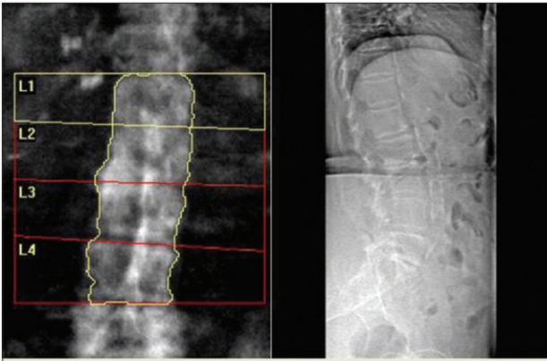
Aortic calcification

Slide 22
Normal progression
Area: L1<L2<L3<L4
BMC: L1<L2<L3<L4
BMD: L1<L2<L3>L4

Slide 23
Look for significant level to level variations

Slide 24
Variation of T score by more than 1 SD should raise suspicion of some anatomical variation or artifact
BMD>1.2 is abnormal

Slide 26
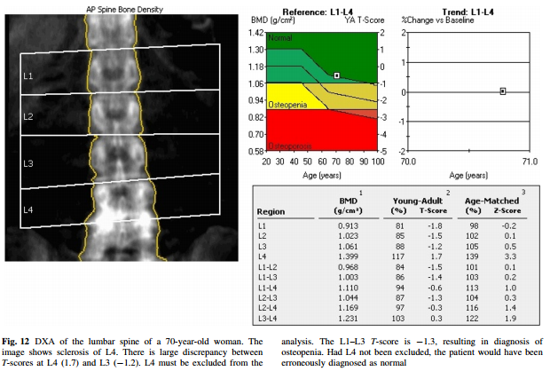

Slide 27
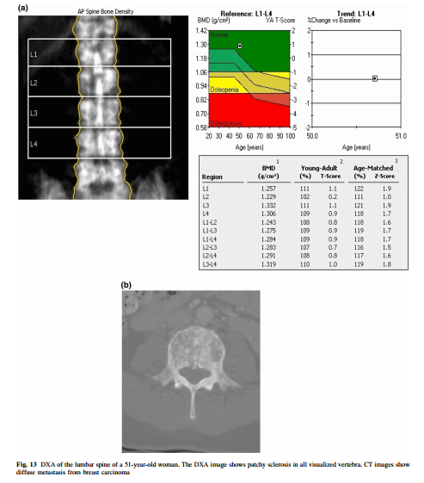

Slide 28
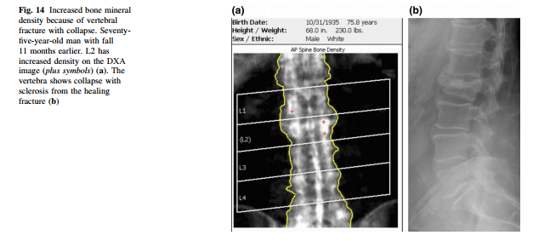

Slide 29
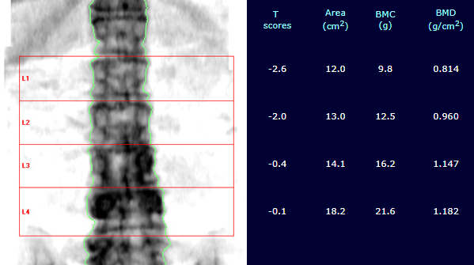

Slide 30
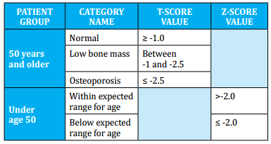

Slide 31
