Slide 1
Regional Rheumatic pain syndrome
Juxtaarticular disorders
Periarthritis

Slide 2
Regional Rheumatic pain syndrome
Tendinitis
Enthesopathies
Bursitis
Capsulitis
Fibromyalgia
Thoracic outlet syndrome
Nerve entrapment syndromes
Reflex sympathetic dystrophy (complex regional pain syndrome)
Notes:
Nonarticular musculoskeletal pain
#0904031

Slide 3
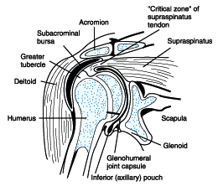
Shoulder

Slide 4
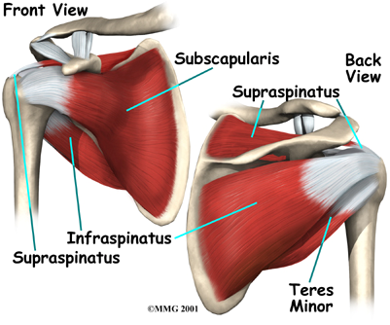
Rotator cuff tendinitis
Rotator cuff
Function
Rotation
Abductio
Stability

Slide 5
Rotator cuff tendinitis
Impingement syndrome
Frequency
Causes
Symptoms
Physical examination
Diagnosis
Treatment

Slide 6
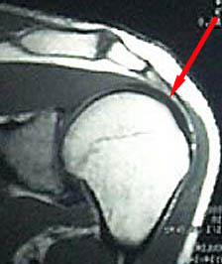
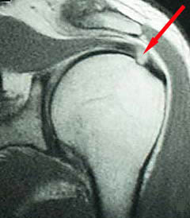

Slide 7
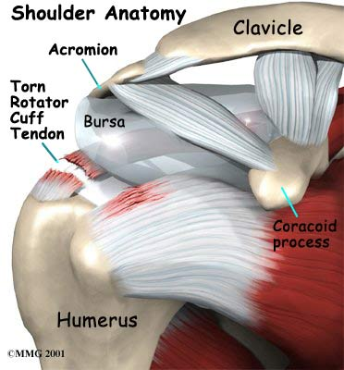
Rotator cuff tear
Causes
Symptoms
Physical examination
Diagnosis
Treatment

Slide 8
Bicipital tendinitis
Causes
Symptoms
Physical exa. Yergason’s test
Diagnosis
Treatment

Slide 9
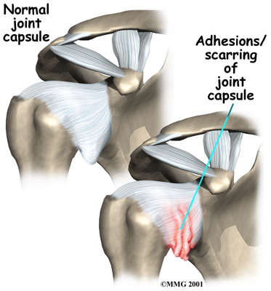
Adhesive Capsulitis
Causes: DM,Mi,CVA
Symptoms
Physical exa.
Diagnosis
Treatment
course

Slide 10
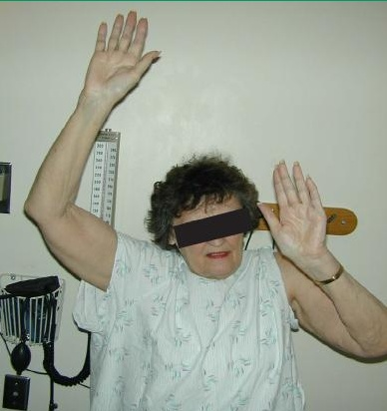

Slide 11
Thoracic outlet syndrome
Definition
Causes
Symptoms neurologic vascular
physical exa. Adson test
Diagnosis: X-Ray EMG MRI

Slide 12
Thoracic outlet syndrome

Slide 13
Olecranon Bursitis
Causes
Symptoms
Diagnosis
Treatment

Slide 14
Tennis Elbow
Causes
Symptoms
Physical Exa.
Diagnosis
Treatment

Slide 15
Golfer’s Elbow
Causes
Symptoms
Physical Exa.
Treatment

Slide 16
Synovial cyst and Ganglion
Definition
Causes
Symptoms
Treatment

Slide 17
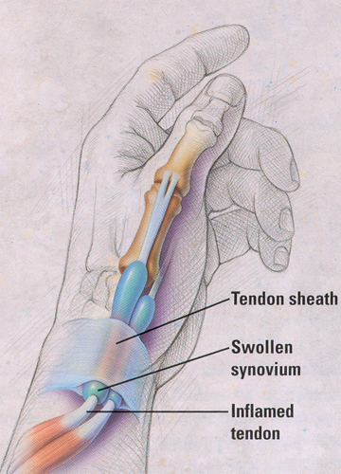
De Quervain’s Tenosynovitis
APL,EPB
Causes
Symptoms
Physical Exam. Finkelstein test
Treatment

Slide 18
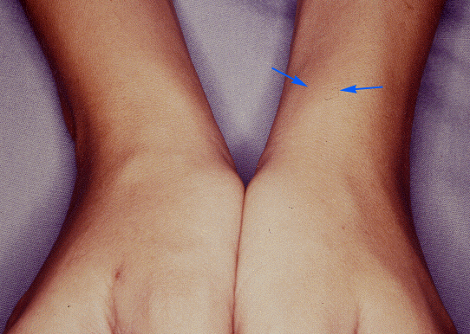
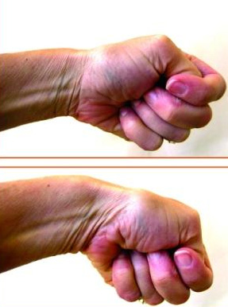

Slide 19
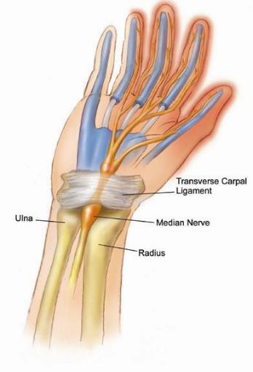
Carpal Tunnel

Slide 20
Carpal Tunnel Syndrome
Causes: pregnancy,trauma,synovitis, hypothyroidism,acromegalia,DM
Symptoms
Physical Exam. Phalen’s sign Tinel’s sign
Diagnosis:NCV
Treatment

Slide 21
CTS

Slide 22
CTS

Slide 23
Dupuytren’s contracture
Definition
Causes:familial, alcoholism,epilepsy,diabetes
Treatment

Slide 24
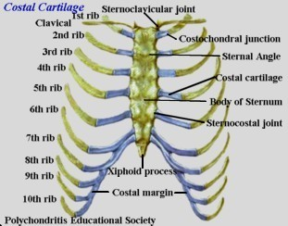
Tietze’s syndrome&costochndritis
Definition
Age<40
Usually one joint
Costochonral joint 2&3
Causes
Differential Diagnosis
Treatment

