Slide 1
Trochanteric Bursitis
Definition
Symptoms
Physical exam
Diagnosis
Treatment

Slide 2
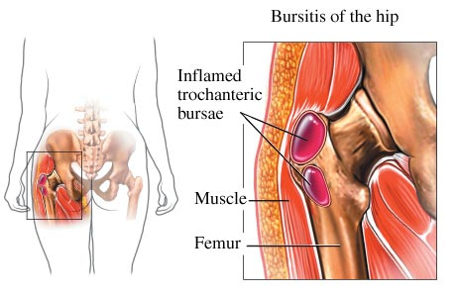

Slide 3
Meralgia Paresthetica
Lateral Femoral cutaneous nerve (L2-L3)
Causes: Diabetes,pregnancy,obesity,trauma
Symptoms
Physical exam
Diagnosis

Slide 4
Baker’s Cyst(popliteal cyst)
Definition
Causes: RA, OA
Symptoms
Rupture
Diagnosis
Treatment

Slide 5
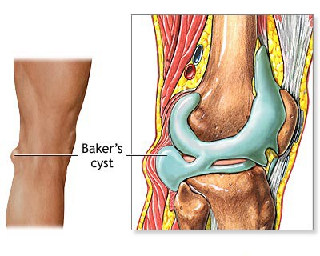

Slide 6
Baker’s Cyst

Slide 7
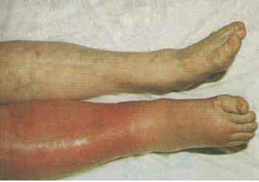

Slide 8
Anserine Bursitis
Sartorius,Gracilis, Semitendinosus
Causes
Symptoms
Diagnosis
Treatment

Slide 9
Prepatellar Bursitis
Housemaid’s knee
Causes
Treatment

Slide 10
Achill’s tendinitis
Causes
Symptoms
Treatment

Slide 11
Complex regional pain syndrome
CRPS is a disorder of the extremities that is characterized by pain, swelling, limited range of motion, vasomotor instability, skin changes, and patchy bone demineralization. It frequently begins following an injury, surgery, or vascular event such as a myocardial infarction or stroke.

Slide 12
Complex regional pain syndrome
Type I: without a definable nerve lesion
Type II: with a definable nerve lesion

Slide 13
Reflex sympathetic dystrophy syndrome(RSDS)
Symptoms:Sever pain,Tenderness,Allodynia, Hyperpathia, Swelling,vasomotor changes,
Three stages
First stage:acute
Second stage:dystrophic
Third stage:Atrophic

Slide 14
RSDS

Slide 15
RSDS Pathogenesis
Causes:Trauma,Peripheral nerve injury, CVA, Mi,Neoplasm,Drugs
Pathogenesis poorly understood
Sympathetic hyperactivity

Slide 16
RSDS Diagnosis
Lab. tests
X-Ray:Patchy osteoporosis
Scintigraphy

Slide 17
Reflex sympathetic dystrophy: osteopenia, wrist (radiograph)
Notes:
Reflex sympathetic dystrophy: osteopenia, wrist (radiograph)
The carpus and adjacent bones have developed a spotty osteopenia caused by the shoulder-hand syndrome. The joints show no narrowing.
#9517010

Slide 18
Reflex sympathetic dystrophy: hands (bone scan)
Notes:
Reflex sympathetic dystrophy: hands (bone scan)
This bone scan demonstrates an extensive, unilateral increase in uptake of radionuclide in the left hand. Uptake is pronounced in the wrist and almost all of the finger joints. This marked, diffuse uptake in the involved extremity is found in many, but not all, cases of reflex sympathetic dystrophy.
#9517020

Slide 19
RSDS Treatment
Etiologic treatment
Analgesic
NSAIDs
Corticosteroids
Calcitonin
Beta blocker

Slide 20
Fibromyalgia
Fibromyalgia is a commonly encountered disorder characterized by widespread musculoskeletal pain, stiffness, paresthesia, nonrestorative sleep, and easy fatigability along with multiple tender points which are widely and symmetrically distributed.

Slide 21
Epidemiology
Sex: predominantly women
Age: mainly in young women
Prevalence:
Female: 3.4%
Male : 0.5%
Rheumatology clinics:20%

Slide 22
Pathogenesis
Disturbed sleep
Low levels of serotonin metabolites in CSF

Slide 23
Clinical Manifestations
Chronic widespread pain
Fatigue
Sleep diturbance
Stiffness
Paresthesias
Irritable bowel syndrome
Raynaud’s phenomenon
Depression
Anxiety

Slide 24
Fibromyalgil Diagnosis
Lab. Tests: normal

Slide 25
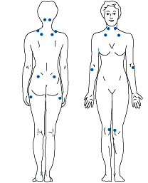
ACR Criteria
Widespread Pain
11 tender point

Slide 26
Fibromyalgia Treatment
Body Exercise
NSAIDs
Antidepressant

