Slide 1
Sjogren Syndrome

Slide 2
Definition
A chronic inflammatory & lymphoproliferative disease with autoimmune features, characterized by:
A progressive mononuclear cell infiltration of exocrine glands (notably the lacrimal & salivary glands)
lead to dryness of the eyes and the mouth.

Slide 3
Types
PRIMARY: (70%)
Without Other Autoimmune Diseases
SECONDARY: With Other Autoimmune Diseases
RA
SLE
PSS
MCTD
PBS
Myositis
Vasculitis
Thyroiditis
The most common disease associated with secondary SS is RA

Slide 4
Epidemiology
Sjogren Syndrome is the third most common autoimmune disease (Fox RI. 2005)
Approximately 90% occur in women
Mainly affects middle age women
In a cohort study of 400 patients:
the average age of the patients was 52.7
93% of the patients were women
(Garcia-Carrasco M, et al. 2002)

Slide 5
Epidemiology
The reported prevalence is 0.05 - 4.8%
The incidence of primary SS is about 4 cases per 100,000 persons.
(Pillemer SR, et al. 2001)

Slide 6
Clinical Manifestations

Slide 7
Presentation
The disease runs usually a rather slow and benign course.
Initial manifestations can be nonspecific)
In a prospective cohort study of 400 patients, 98% presented with dry mouth and 93% presented with dry eyes (Garcia-Carrasco M, et al. 2002)

Slide 8
clinical manifestations
The clinical manifestations of SS are divided into :
the exocrine gland features
the extraglandular disease features

Slide 9
the exocrine gland features
keratoconjunctivitis sicca
Xerostomia
Salivary Gland enlargement
Others (Exocrine gland involvement in the skin, upper airway tract & GUT)

Slide 10
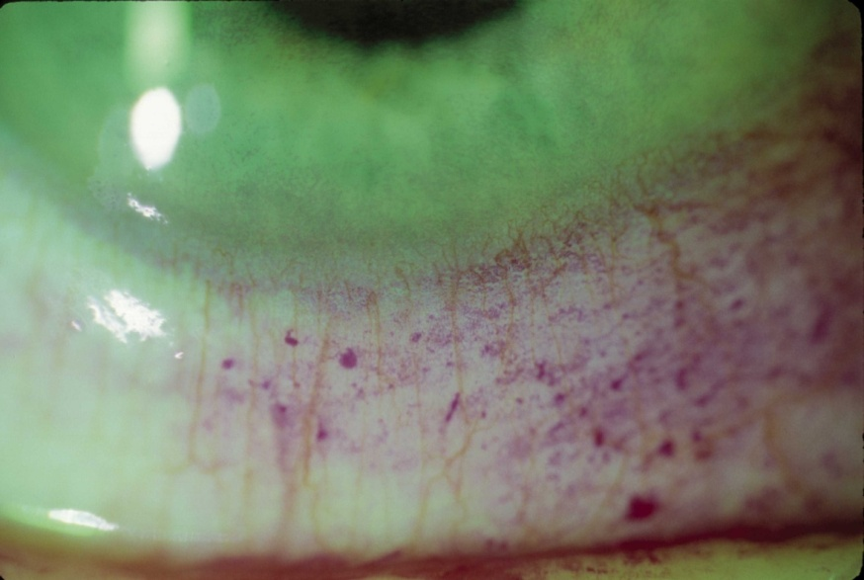
keratoconjunctivitis sicca (Dry Eye)
Foreign- body sensation
Burning eyes
Decreased tearing
Photosensitivity
Itching
Blepharitis
Fluctuating vision
Conjunctivitis

Slide 11
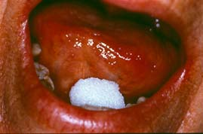
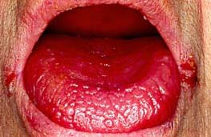
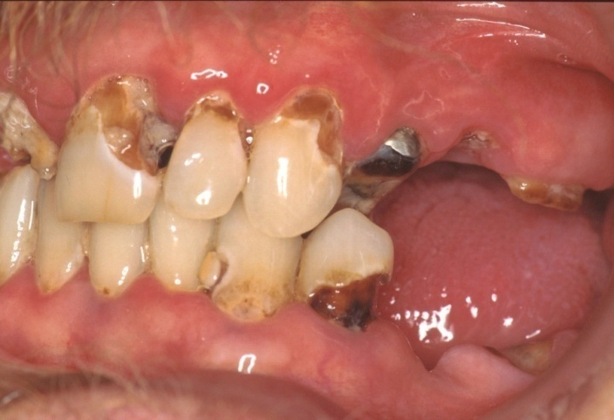
Xrostomia (Dry Mouth)
A parched feeling in the mouth, often extending to the throat
Difficult eating without supplemental liquids
( cracker sign )
Accelerated Tooth decay
Candidiasis

Slide 12
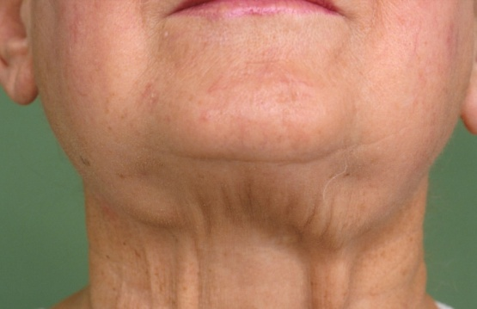
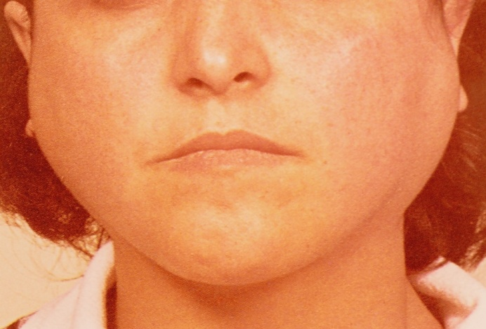
Salivary Gland Enlargement
Parotid or major salivary gland enlargement occurs in 60% PSS. (Tzioufas AG. 2007)
Parotid enlargement might begin unilaterally, but often becomes bilaterally.
Parotid Abscess
Chipmunk-like faces
Salivary Calculi
Lymphoma ( a dominant hard mass)

Slide 13
Other Manifestations 50-70%
Dry Nose:
inflammation, congestion, crusting and epistaxis
Dry Trachea:
The most common symptom of laryngeal, tracheal, and bronchial involvement is a dry cough
Dry Skin:
reduced sweat volume, pruritus and excoriation,
super infection
Dry Vagina:
pruritus, irritation, dyspareunia

Slide 14
the extraglandular disease features
Musculoskeletal
Vascular
Pulmonary
Gastrointestinal
Renal
Neurologic
Hematologic
Endocrinologic

Slide 15
Musculoskeletal
Prevalence 54% – 84%
(Carsons S. in: Kelley's Textbook of Rheum, 2008)
Arthralgia & Transient Mild joint Synovitis
Muscle Pain
Myositis:
Positive Biopsy: 73%
Clinical Myositis: 11%
Fibromyalgia 27% (Lindvall B. 2002)

Slide 16
Vascular
Prevalence 15%
(Carsons S. in: Kelley's Textbook of Rheum, 2008)
Raynaud’s Phenomenon 13% - 66%
From Hypersensitivity vasculitis to PAN
Purpura (palpable & non-palpable) in association with cryoglobulinaemia & hyperglobulinaemia
(Ramis-Casals M. 2004)
Urticaria & Necrotising Vasculitis

Slide 17
Pulmunary
Dry Cough 40% - 50%
Dyspnea & Chest pain 9% - 43%
Abnormal HRCT 65% - 92%
ground glass, bronchiectasis, septom thickening, parenchymal nodules and cysts
Abnormal PFTs (MEF & DLCO) 75%

Slide 18
Gastrointestinal
Xerostomia
Dysphagia 75%
Esophagal web 10%, Dysmotility
Gastric 50%
Atrophic Gastritis 10% – 25%
superficial Gastritis 80%

Slide 19
Hepatic & Pancreas
Autoimmune Hepatitis (25%)
Anti smooth muscle antibody 7% – 33%
Primary Biliary Cirrhosis
Anti mytochondrial antibody 7% – 13%
Sialoadenitis in PBC 93%
Clinical Sjogren’s in PBC 33% - 47%
Hpatitis C
Clinical Sjogren’s in Hepatitis C 57% - 77%
Hepatitis C in Sjogren’s 6% - 19%
Sub clinical pancreatic involvement is common
hyper amylasemia: 25%

Slide 20
Renal
Prevalence 4%
Distal Renal Tubular Acidosis
Hypokalemic Paralysis (rare)
Glomerular involvement (rare)

Slide 21
Neurologic
Prevalence 22% - 76%
Peripheral Neuropathy 10% - 20%,
(mostly in lower limb)
Cranial Neuropathy
(particularly trigeminal neuropathy)
Central Nervous System (Rare)
may be Hemiparesia, Epilepsy,
Encephalitis, MS-like lesions.

Slide 22
Heamatologic & Lab Finding
Anemia 20% - 25%
Leukopenia 10% - 16%
Thrombocytopenia 13%
⬆ ESR 80% - 90%
CRP normal
Hypergama 80%
ANA 55% - 97%
RF 80%
Cryoglobulins (type II) 30%
⬇ C3, C4 24%
Ro/SSA 45% - 70%
La/SSB 20% - 50%
α-fodrin 20% - 95%
(Mavragani CP. 2000),
(Garcia-Carrasco M. 2002)
(Ramos-Casals M. 2002)
(Ramos-Casals M. 2005)

Slide 23
The American-European Consensus Group classification criteria Subjective
(Positive = a positive response to at least one of the three following questions)
I. Ocular symptoms:
Have you had daily, persistent, troublesome dry eyes for more than 3 months?
Do you have a recurrent sensation of sand or gravel in the eyes?
Do you use tear substitutes more than three times a day?
II. Oral symptoms:
Have you had a daily feeling of dry mouth for more than 3 months?
Have you had recurrently or persistently swollen salivary gland as an adult?
Do you frequently drink liquids to aid in swallowing dry food?
Vitali C et al., Ann Rheum Dis. 2002

Slide 24
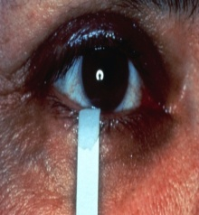
The American-European Consensus Group classification criteria Objective
III. Ocular signs (positive result in at least one of the following tests)
Schirmer’s I test (< 5 mm/5 min)
Rose-Bengal score or another ocular dye score
( >4 according to von bijsterveld’s scoring system )
IV. Histopathology
focus score > 1
defined as a number numbers of lymphocytic foci that are adjacent to normal-appearing mucous acini and contain more than 50 lymphocytes per 4 mm² of glandular tissue.
Vitali C et al., Ann Rheum Dis. 2002

Slide 25
The American-European Consensus Group classification criteria Objective
V. Salivary gland involvement (positive result in at least one of the following tests)
Unstimulated salivary flow (less than 1.5ml in 15 minutes)
Parotid sialography
presence of diffuse sialectasia, (punctate, cavitary or destructive,
pattern), without evidence of obstruction in the major ducts
Salivary scintigraphy (delayed uptake, reduced concentration and/or delayed excretion of tracer)
VI. Autoantibodies:
Ro(SSA) and/or La(SSB)
Vitali C et al., Ann Rheum Dis. 2002

Slide 26
The American-European Consensus Group classification criteria
Rules for classification:
Definitive primary SS
presence of any four of the six items
Presence of 3 objective criteria
in patients without any potentially associated disease
Secondary SS
item‑1 or item‑2 plus any two from items 3, 4, 5
in patients with a potentially associated disease
(another connective tissue disease)
Vitali C et al., Ann Rheum Dis. 2002

Slide 27
Ocular symptoms or
Oral symptoms
-
+
No SS
III. Ocular signs
-
+
IV. Histopathology lip biopsy focus score ≥1
IV. Histopathology lip biopsy focus score ≥1
-
-
+
+
No SS
VI. Anti-Ro(SSA) or anti-La(SSB)
SS
V. Tests for salivary gland involvement
+
-
+
-
V. Tests for salivary gland involvement
No SS
SS
SS
-
+
No SS
SS

Slide 28
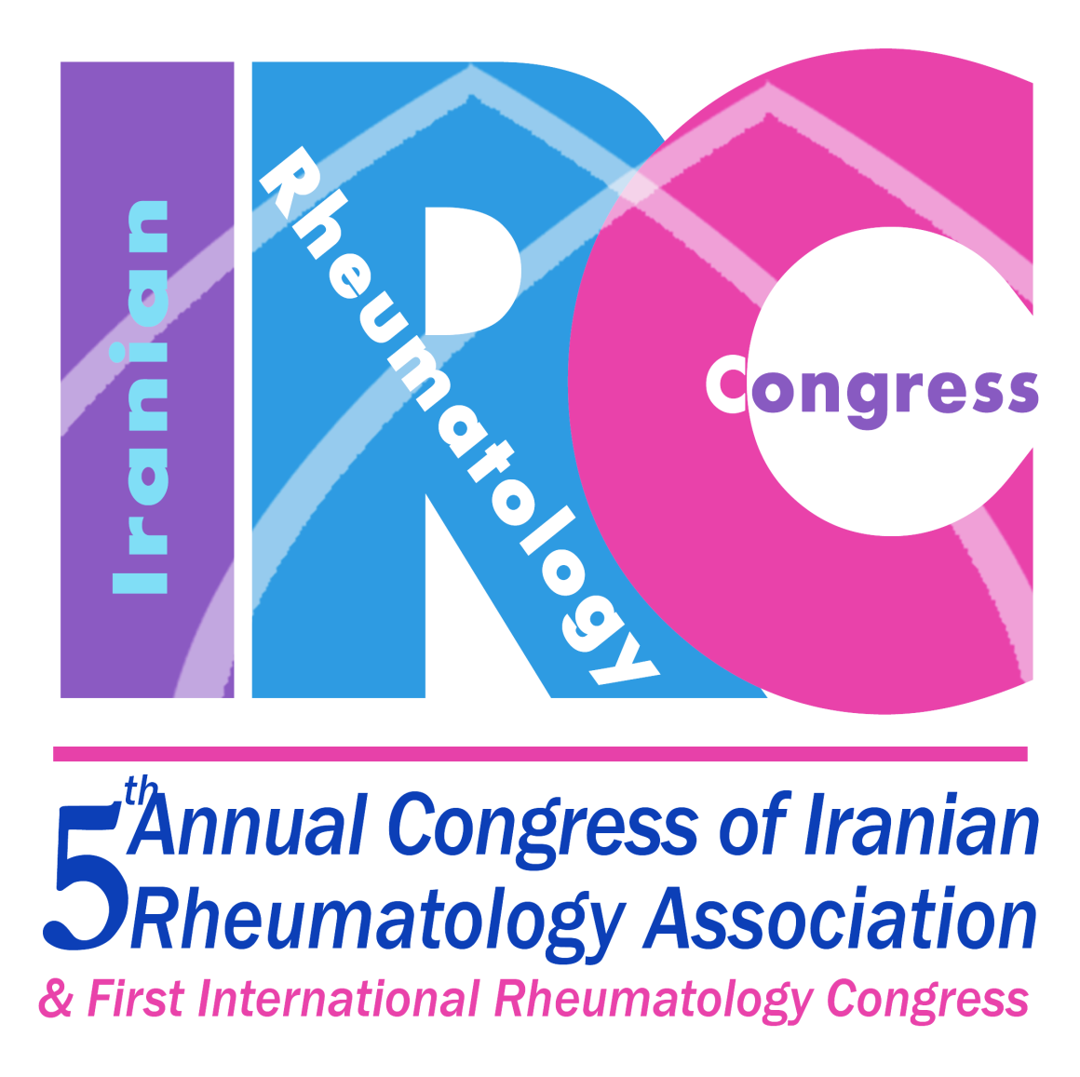
DIFFERENTIAL DIAGNOSIS OF SJOGREN’S SYNDROME
Systemic Conditions Associated with Sicca Symptoms:
Viral: mumps, EBV, HIV, HTLV-1
Sarcoidosis
Amyloidosis
Lymphoma
Graft-versus-host disease
Radiatione therapy
Fibromyalgia-like syndromes: Chronic fatigue syndrome
Aging
Dysproteinemia, Hemochromatosis

Slide 29
DIFFERENTIAL DIAGNOSIS OF SJOGREN’S SYNDROMS
Diffuse infiltrative lymphocytosis syndrome (DILS) in 3% to 8% of patients with Human immunodeficiency virus was seen.
These patients are more commonly male, lack specific auto antibodies and display a propensity to develop lymphoma.

Slide 30
DIFFERENTIAL DIAGNOSIS OF SJOGREN’S SYNDROME
IGg-4 Syndrome
an entirely new disease spectrum: IgG4-related systemic disease (IgG4-RSD)
IgG4-RSD is an under recognized condition about which knowledge is now growing rapidly
Organ infiltration by IgG4-positive plasma cells in a variety of contexts: salivary gland disease, lacrimal gland enlargement, hepatobiliary dysfunction, aorta and others.
Serum concentration of IgG4 was elevated to 10 times above the upper limit of normal and tissue stained abundantly for IgG4.

Slide 31
IgG4-related systemic disease
IgG4-related systemic disease (IgG4-RSD) is a recently recognized systemic condition characterized by unique pathological features that affect a wide variety of organs.
In 2003, Kamisawa et al. reported multiple extra pancreatic lesions in patients with autoimmune pancreatitis (AIP). The histopathology identified within affected organs was identical to that found in the pancreas.
Kamisawa et al. suggested that AIP was not confined to the pancreas, but rather was part of a larger systemic disease.
They proposed the existence of a novel entity termed “IgG4-related autoimmune disease”.

Slide 32
Various terms for IgG4-related systemic disease:
IgG4-related systemic disease
IgG4-related sclerosing disease
IgG4-related disease
IgG4 syndrome
IgG-related systemic sclerosing disease
IgG4-related autoimmune disease
Hyper-IgG4 disease
Systemic IgG4-related plasmacytic syndrome (SIPS)
IgG4-postive multiorgan lympho-proliferative syndrome

Slide 33
IgG4-related systemic disease
Epidemiologic information about IgG4-RSD is sparse. The male: female ratio is approximately 5: 1.
The clinicopathological definition of IgG4-RSD remains in evolution and its pathophysiology is still undelineated

Slide 34
IgG4-related systemic disease
Patients rarely manifest constitutional symptoms.
Histories of asthma, eczema, or atopy are reported frequently.
Tumorous swelling, extensive fibrosis, and obliterative phlebitis are other shared features.
Presence of typical histopathological features, including the existence of numerous IgG4+ plasma cells within affected tissue, is the gold standard for the diagnosis of IgG4-RSD.
Patients with IgG4-RSD have an excellent but often unsustained clinical responses to glucocorticoid .

Slide 35
IgG4-related systemic disease
Organ involvement in IgG4-related systemic disease
Pancreas
Bile duct
Liver
Gastrointestinal tract
Salivary and lacrimal glands
Chronic sclerosing sialadenitis (also called Kiittner's tumor).
Retroperitoneum and mesentery
Aorta
Thyroid
Breast
Lung
Kidney
Pituitary gland
Meninges
Prostate
Skin
Pericardium
Lymph nodes

Slide 36
IgG4-related systemic disease
Organ involvement in IgG4-related systemic disease
Orbit
The involvement of orbital tissues by IgG4-RSD has been divided into:
-- chronic sclerosing dacryoadenitis
-- inflammatory orbital pseudotumors
The process can affect the lacrimal gland (dacryoadenitis), extraocular muscles (orbital myositis), the uveal tract (uveitis), optic nerve sheath.

Slide 37
IgG4-related systemic disease
Diagnosing IgG4-related systemic disease
Criteria for the overall diagnosis of IgG4-RSD have not yet been developed.
The identification of typical histopathological features, including the presence of numerous IgG4+ plasma cells within affected tissue, remains the gold standard for the diagnosis of IgG4-RSD.

Slide 38
IgG4-related systemic disease
Diagnosing IgG4-related systemic disease
polyclonal Serum IgG4 concentrations more than twice the upper limit of normal are considered highly specific.
Serum inflammatory markers such as ESR and CRP are usually modestly elevated in IgG4-RSD.
Increased levels of serum IgE and peripheral eosinophilia are also reported in some patients.
Autoantibodies Ro/SSA and La/SSB antigens are absent.

Slide 39
Conclusions:
The clinicopathological definition of IgG4-RSD remains in evolution and its pathophysiology is still undelineated.
IgG4-related systemic disease (IgG4-RSD) is a systemic fibroinflammatory condition that can affect any organ system. Prompt recognition and management of this disease process are necessary to prevent sclerosis and permanent organ damage.

Slide 40
Treatment
5th iranianrac Mashhad

Slide 41
Treatment of Xerostomia
5th iranianrac Mashhad
Avoid drug worse sicca
Avoid low humidity
Painful mouth may be differ from dryness
Adequate Hydration
Good oral hygiene (Toothbrushes, Toothpaste)
Frequent visit of Dentist ( Floss or Fluoride)
Oral candidiasis: Nistatin elixir, Miconazol gel

Slide 42
Treatment of Xerostomia
5th iranianrac Mashhad
Replacement of Oral Secretions
1- Water
2- Artificial Saliva ( Methylcellulose)
Use after water
Different viscosity
Different preference
Spray, lozenges, pastilles

Slide 43
Treatment of Xerophtalmia
5th iranianrac Mashhad
Artificial tears
Tear conservation
Other treatments
Complications

Slide 44
Treatment of Dryness
5th iranianrac Mashhad
Tracheal dryness
Saline nasal spray, nasal lavage , humidifier , PPI
Skin Dryness
Moisturizing lotions, Bath
Vaginal dryness
Vaginal moisturizer , Vit E cream, topical vaginal
estrogen

Slide 45
Treatment of Dryness
5th iranianrac Mashhad
Stimulation of existing salivary flow
Sugarless candies
Fruit slice
Sugar-free gums
Sialogogues
Pilocarpine(Salagen)
Cevimeline(Evoxac)

Slide 46
Treatment of Systemic Manifestation
5th iranianrac Mashhad
Musckuloskeletal
Analgesics, NSAIDs
DMARDs: HCQ
Cardiopulmonary
lymphocytic interstitial pneumonitis: GC with CYP 500-1000 mg monthly, AZT2.5 mg/Kg
Pulmonary emboli

Slide 47
Treatment of Systemic Manifestation
5th iranianrac Mashhad
Renal disease
RTA: Sodium bicarbonate
GN: Based on Bx, GC, CYC, Cellcept, same as lupus
Gastrointestinal disorders
GERD: PPI, Promotitity agents, Dietary modification
Billiary cirrhosis: Chelate bile salt
Consider HCV has SS-like syndrome

Slide 48
Treatment of Systemic Manifestation
5th iranianrac Mashhad
Endocrine disorder
Hypothyroidism: Thyroid replacement
Neurologic
Peripheral vasculitic neuropathy: High dose GC and Immunosuppressive , IVIG in CIDP
CNS vasculitis: High dose GC and Immunosuppressive

Slide 49
Treatment of Systemic Manifestation
5th iranianrac Mashhad
Cutaneous
Leukocytoclastic vasculitis: similar cutaneous vasculitis
Maculopapular rash: moisturizers and HCQ
Fatigue ( common, multifactorial)
Active disease: HCQ, Low dose GC , NSAID
Thyroid hormone
Fibromyalgia: Antidepressants, SSRIs
Physical therapy and multivitamin

